Slide 1
Automated kinetic modeling in Stan and its application to the methionine cycle
Nicholas Cowie
Quantitative Modeling of Cell Metabolism (QMCM)
- DTU

Slide 2
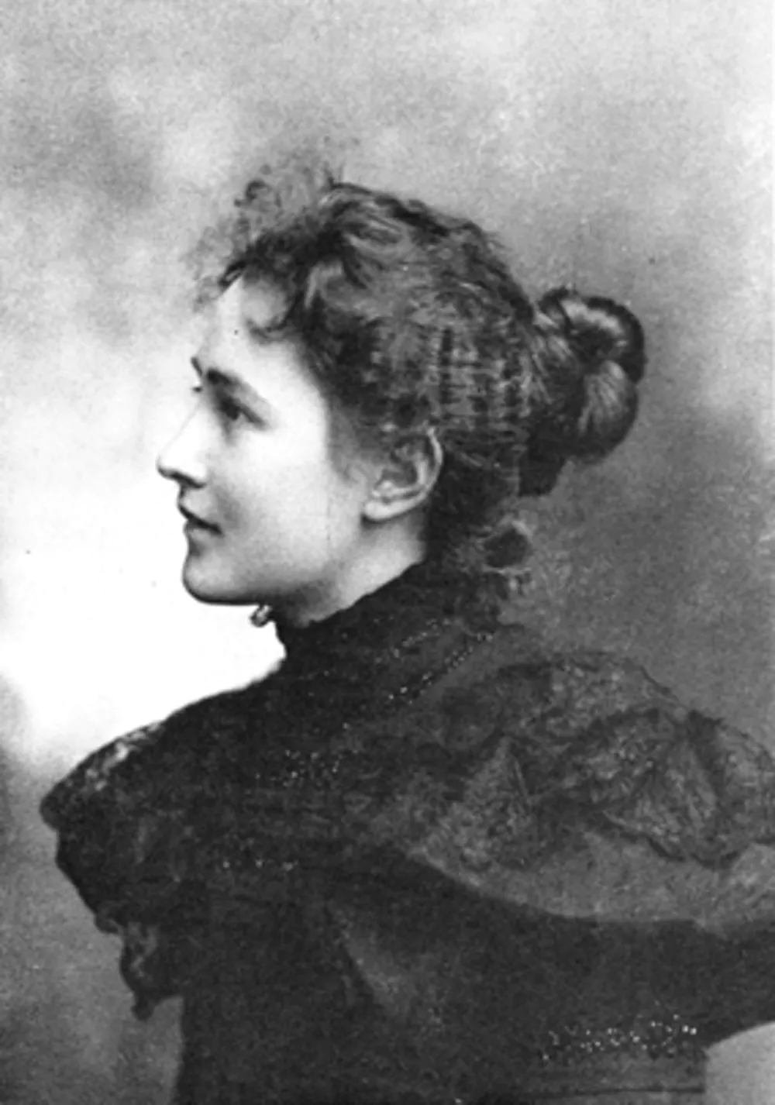
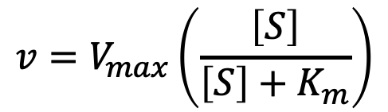
From enzymes to networks
$$v=V_{max}\left(\frac{\left[S\right]}{\left[S\right]+K_{m}}\right)$$
Maud Menten – Co-author of Michaelis-Menten kinetics

Slide 3
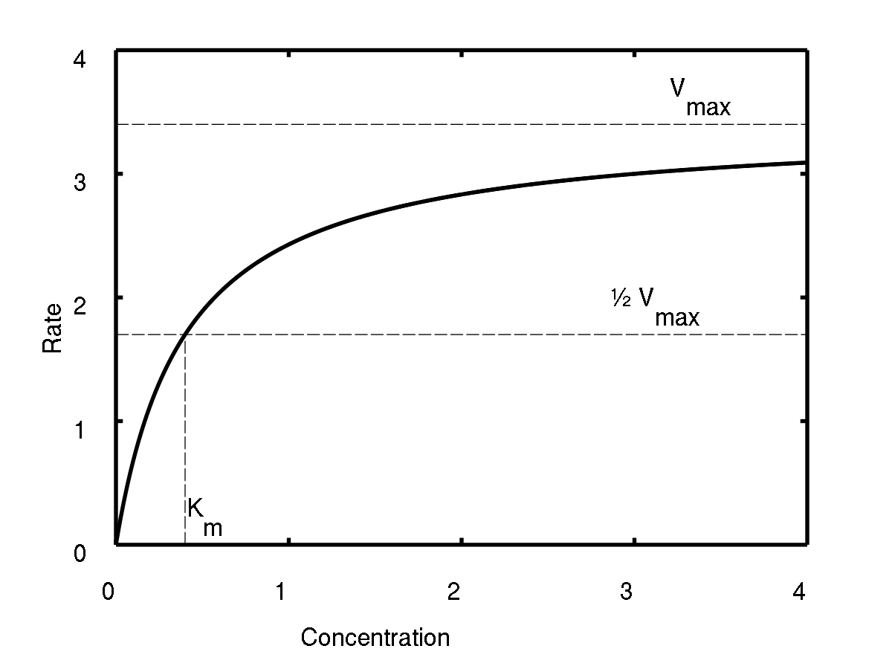
Measuring Kinetic Parameters

Slide 4
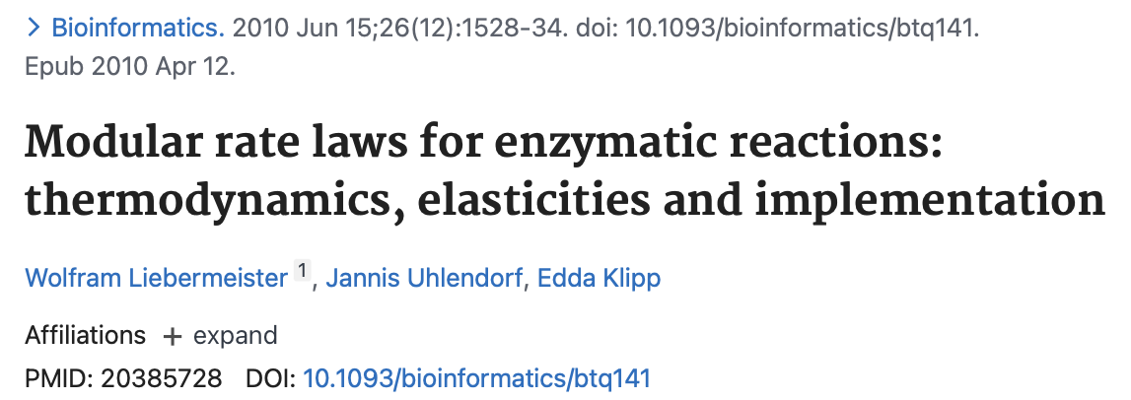
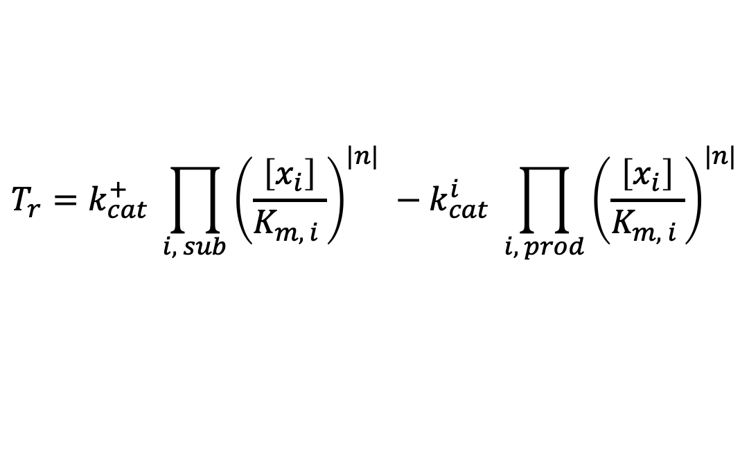
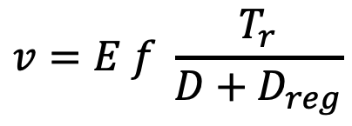
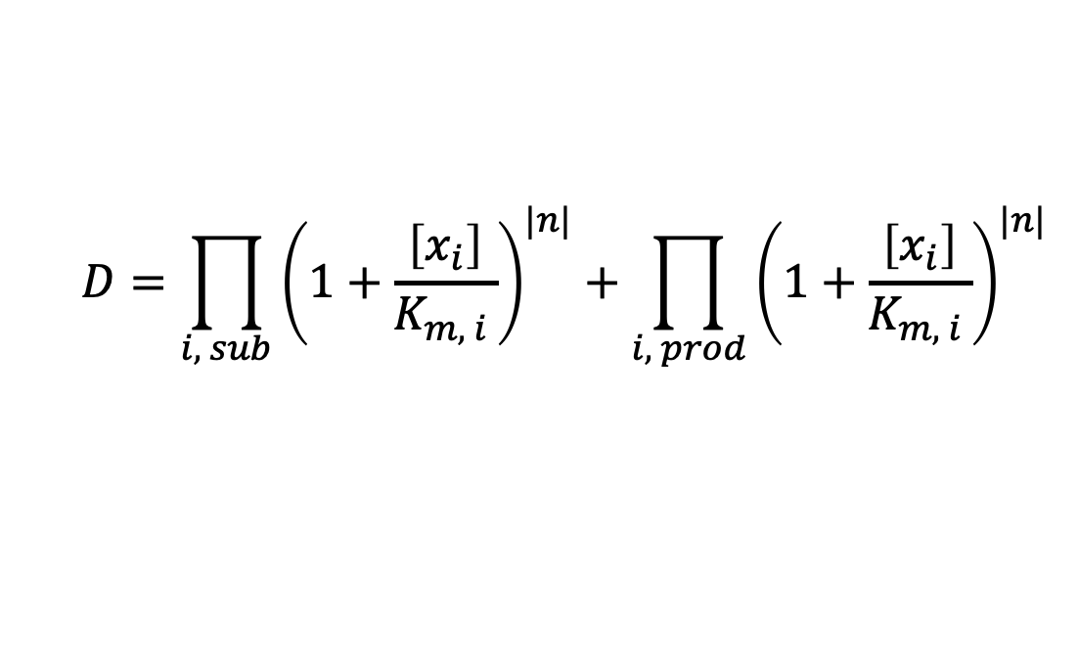
Standardised rate laws
Allosteric regulation
Phosphorylation
More comprehensive rate laws
Allosteric Term
$$v=E f \frac{T_{r}}{D+D_{reg}}$$
Competitive Inhibition Term
$$T_{r}=k_{cat}^{+} \prod_{i, sub}{{\left(\frac{\left[x_{i}\right]}{K_{m, i }}\right)}^{|n|}} −k_{cat}^{i} \prod_{i, prod}{{\left(\frac{\left[x_{i}\right]}{K_{m, i }}\right)}^{|n|}}$$
$$D=\prod_{i, sub}{{\left(1+\frac{\left[x_{i}\right]}{K_{m, i }}\right)}^{|n|}}+\prod_{i, prod}{{\left(1+\frac{\left[x_{i}\right]}{K_{m, i }}\right)}^{|n|}}$$

Slide 5
Interconnected -Omes
Genome
Metabolome
Growth Condition
Transcriptome
Fluxome
Proteome

Slide 6
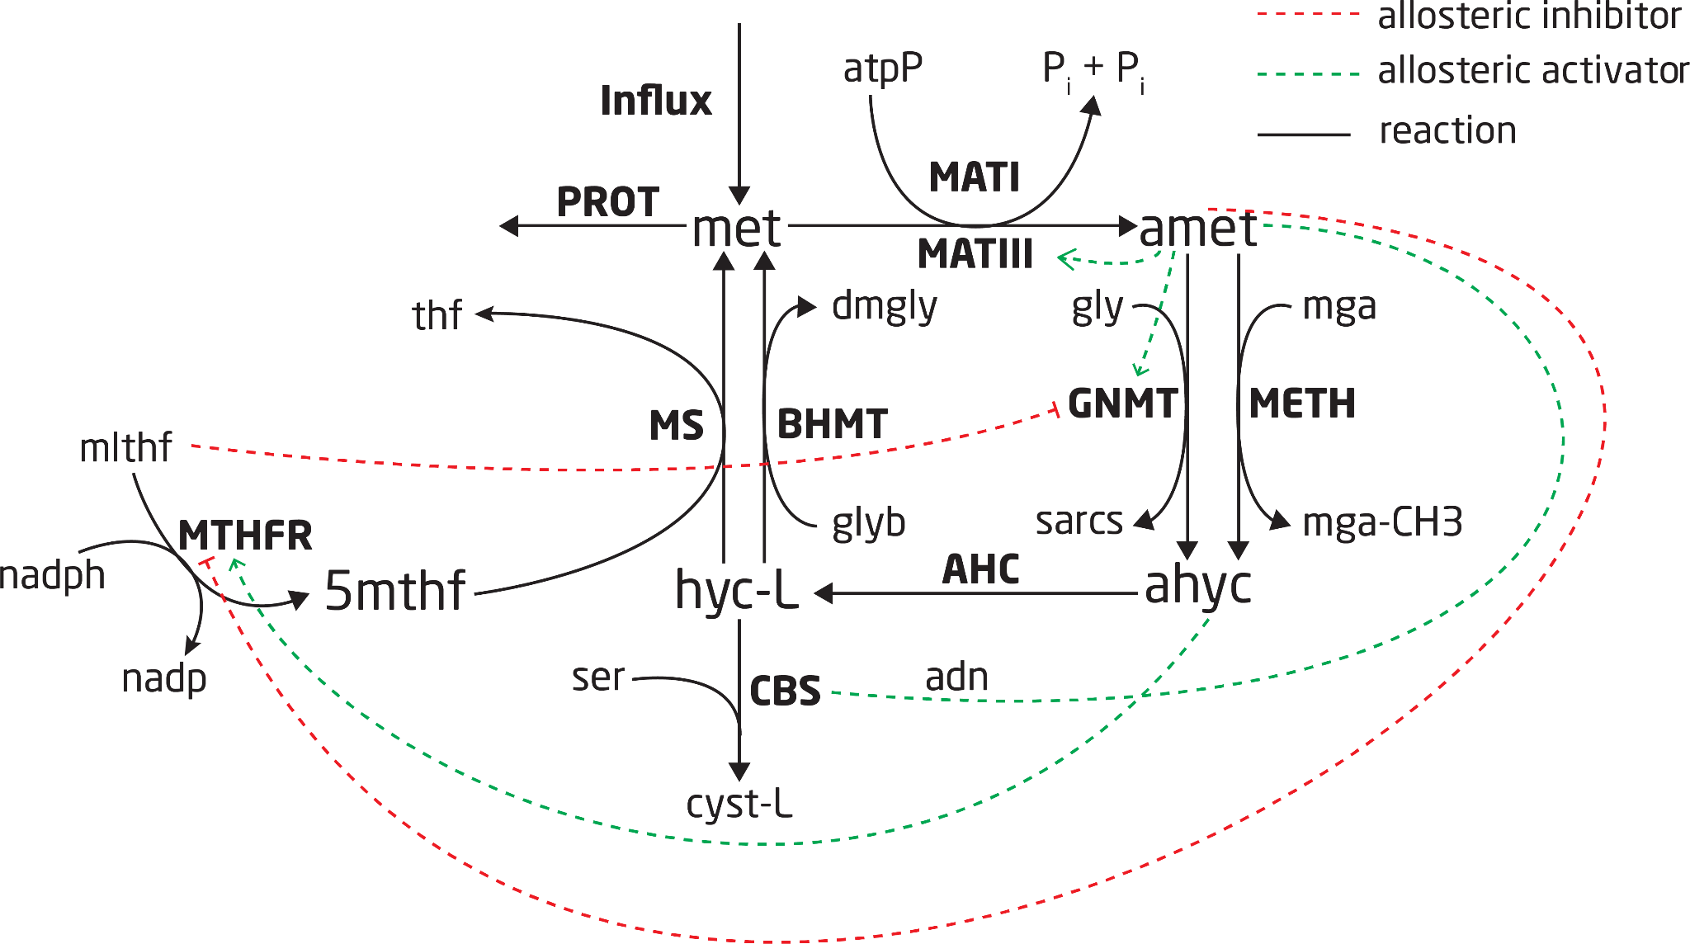
Connecting these enzymes together
Bold represents reactions
Normal represents metabolites

Slide 7
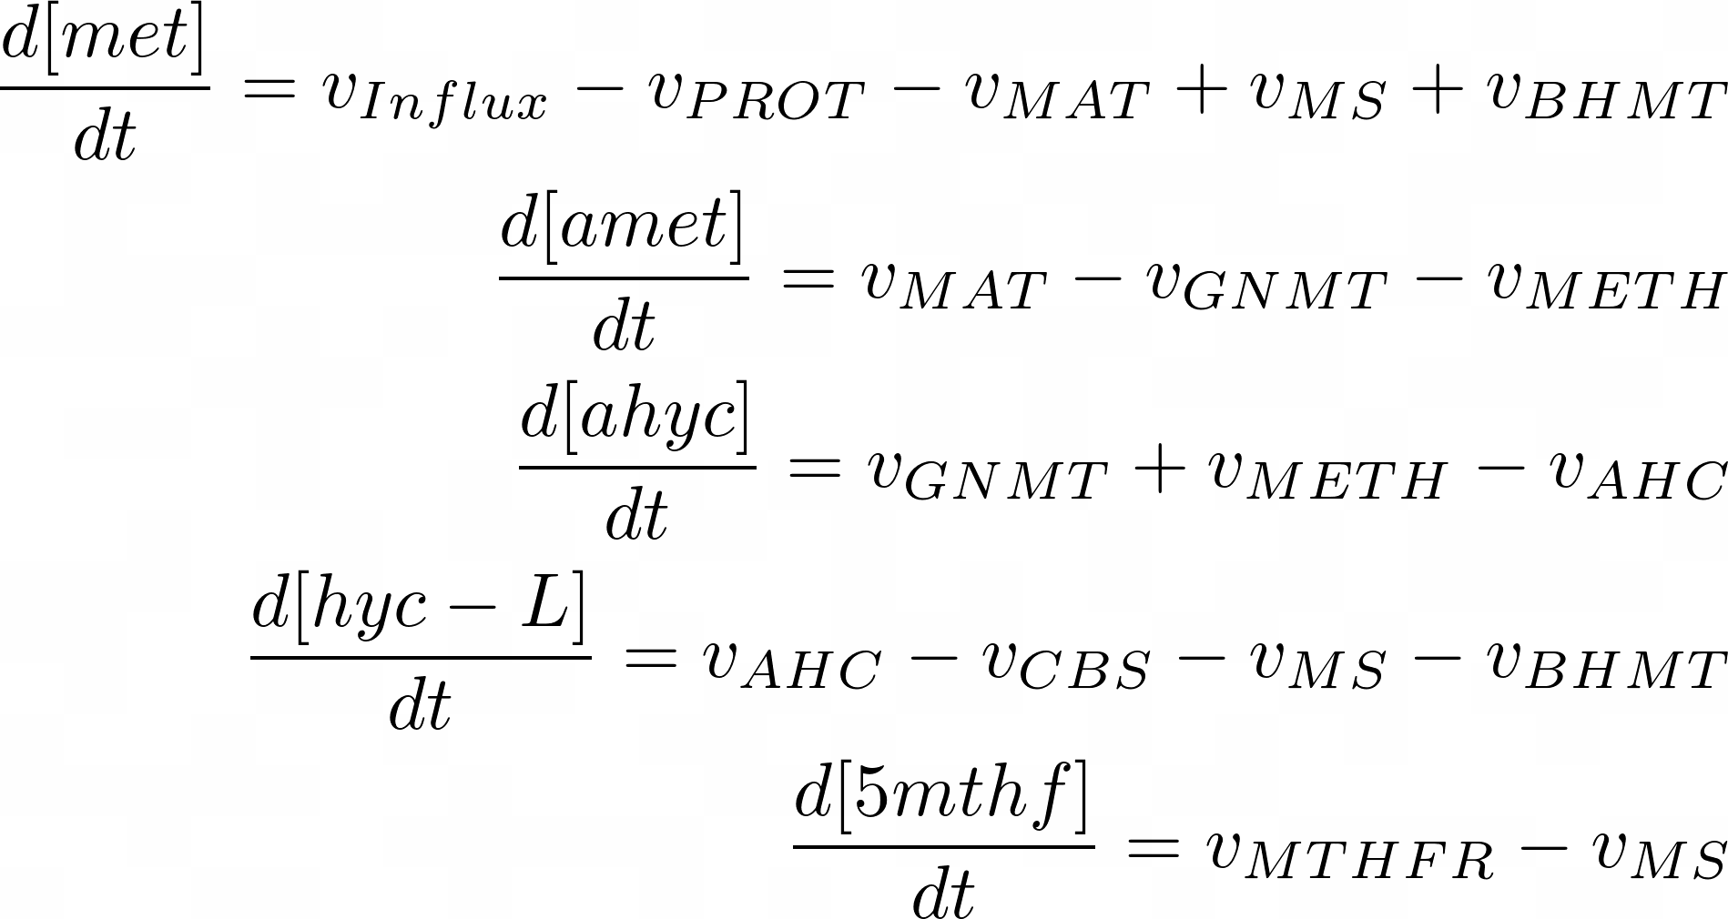
Connecting these enzymes together
Bold represents reactions
Normal represents metabolites

Slide 8
In an ideal world
Construct kinetic model
Measure kinetic parameters
Predict cellular behaviour

Slide 9
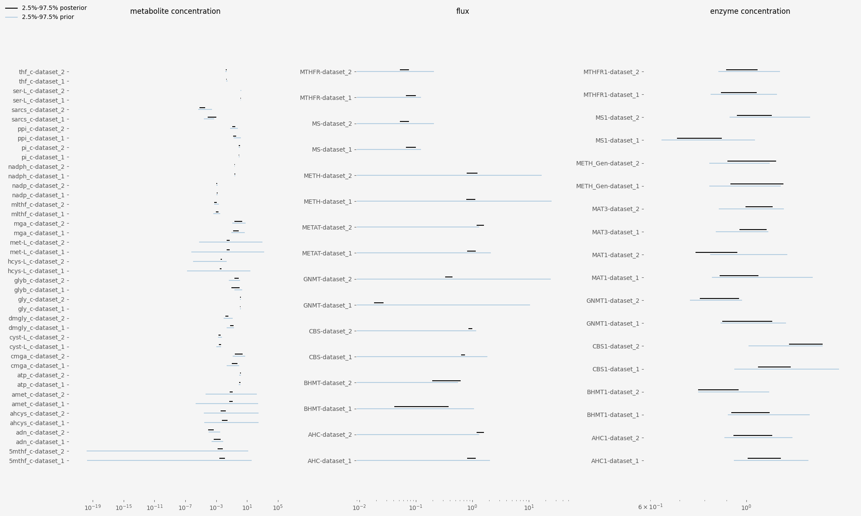
Not so fast!
Prior + conditional on measurements
Using only prior knowledge
Notes:
With and without measurements

Slide 10
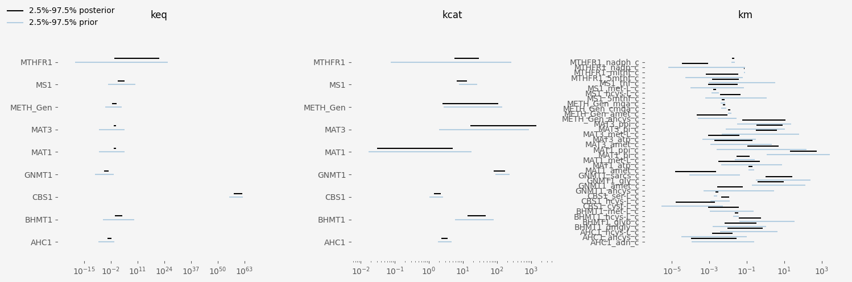
Not so fast!
Prior + conditional on measurements
Using only prior knowledge

Slide 11
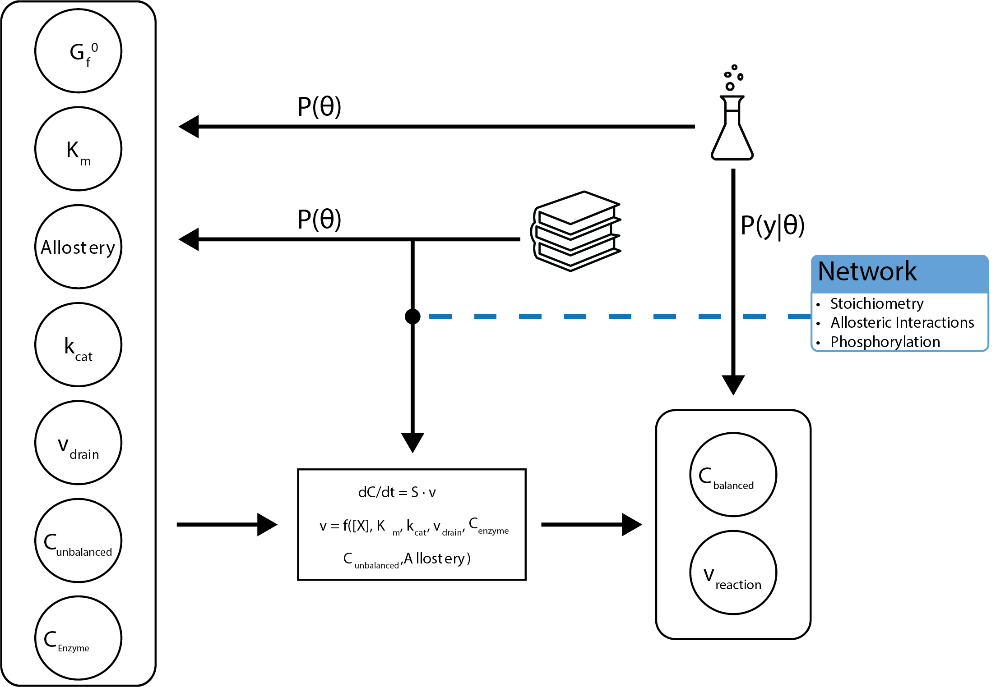
Statistical Model

Slide 12





Maud
Input
Computation
Output
A directory containing
Priors
Measurements
Sampler instructions
Kinetic model definition
A shell command triggering
User input -> Stan input
HMC sampling
Post-processing
A directory containing
Samples
Debug info
The input directory

Slide 13
Automate construction of kinetic model
13

Slide 14
Automate construction of kinetic model
Generate statistically sound parameter sets
14

Slide 15
Challenges

Slide 16
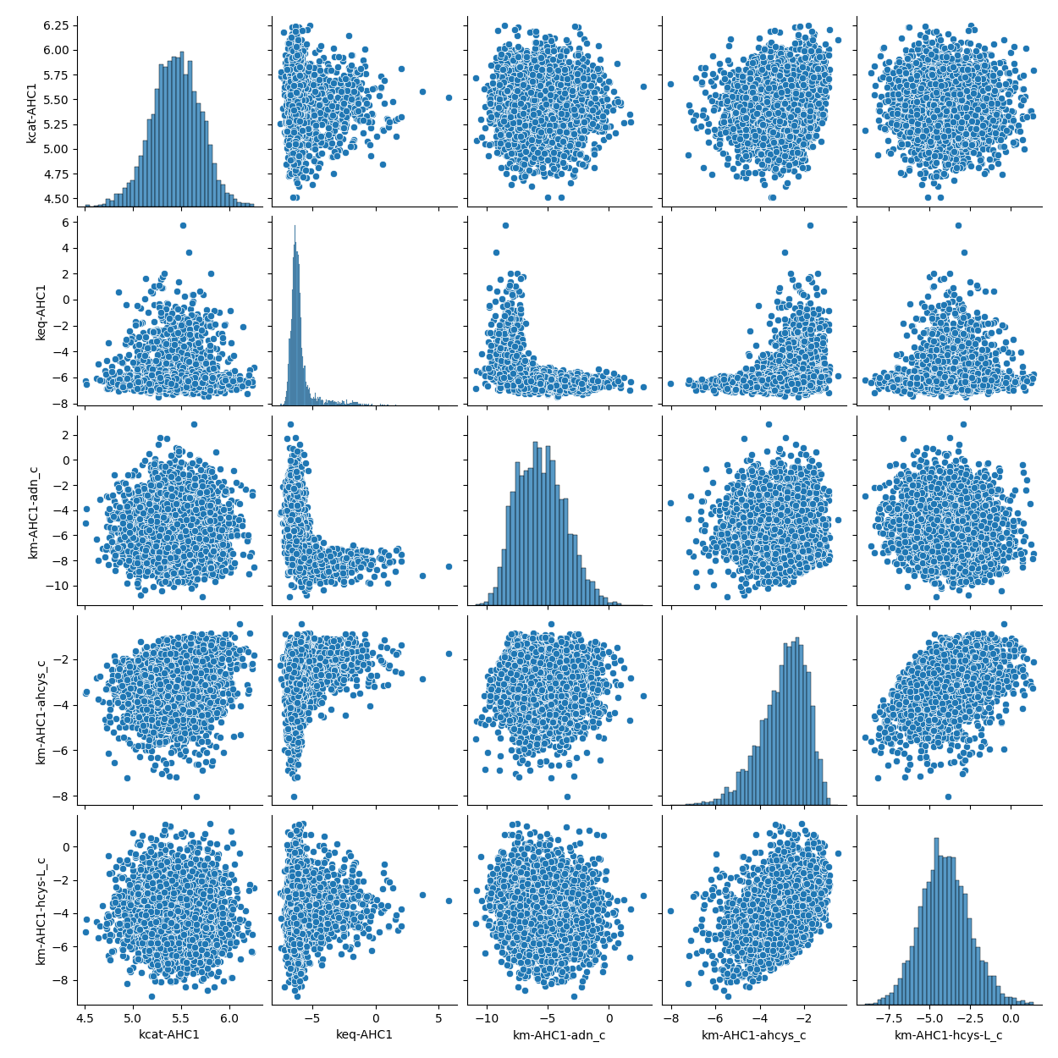
High dimensional correlations result in difficult posteriors

Slide 17
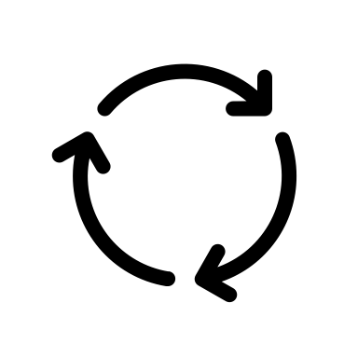

Hanging on in quiet desperation is the Stan way
Modeling is an iterative process
Kinetic models are expensive:
ODE system evaluated every step
AFAIK only parallisable on experiment level

Slide 18

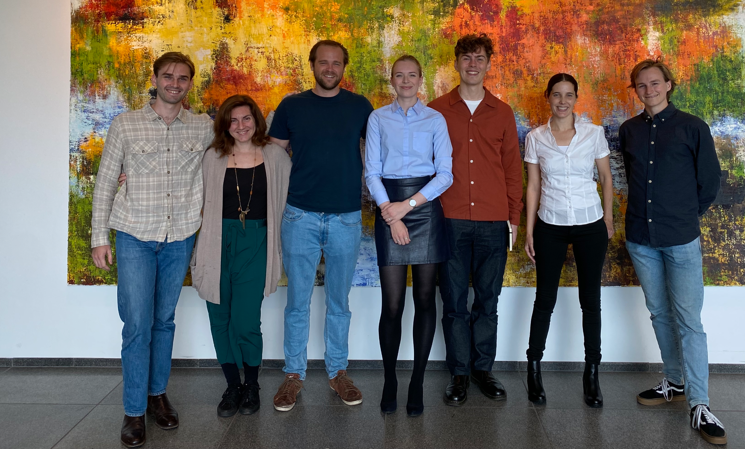
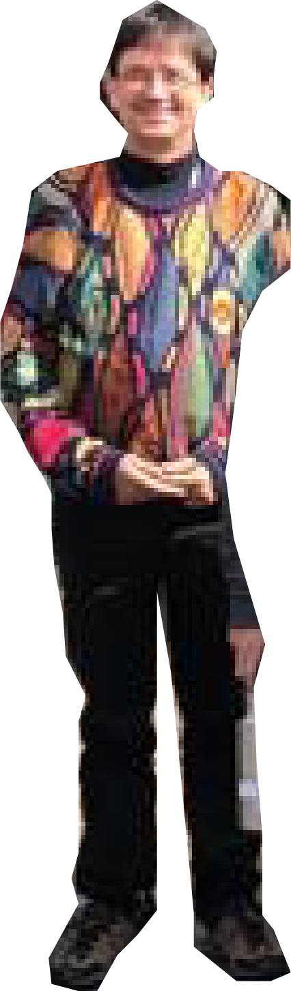
Acknowledgments
Supervisors:
Lars Keld Nielsen
Teddy Groves
Pedro Saa
Quantitative modelling of cell metabolism

Slide 19
Further Information

